Slide 1
Romani Women’s Literature

Slide 3
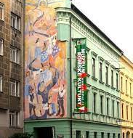
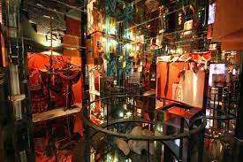
Informations
https://romea.cz/en
Muzeum Romské Kultury
https://www.rommuz.cz/en/online-museum/the-museum-at-yout-home/
The Journal Romano Džaniben (Texts on line)
https://www.dzaniben.cz/article.html?a=100a3df14d146731ff8a9ed055bfb060&m=5a450810cdad2b91b3007973a528450b&sm=d9e18ff16d3d409b93e34a3b7b0ea488
Štátna vedecká knižnice v Prešove. Dokumentačno informačné centrum rómskej kultúry
https://www.svkpo.sk/narodny-projekt-dokumentacno-informacne-centrum-romskej-kultury

Slide 4
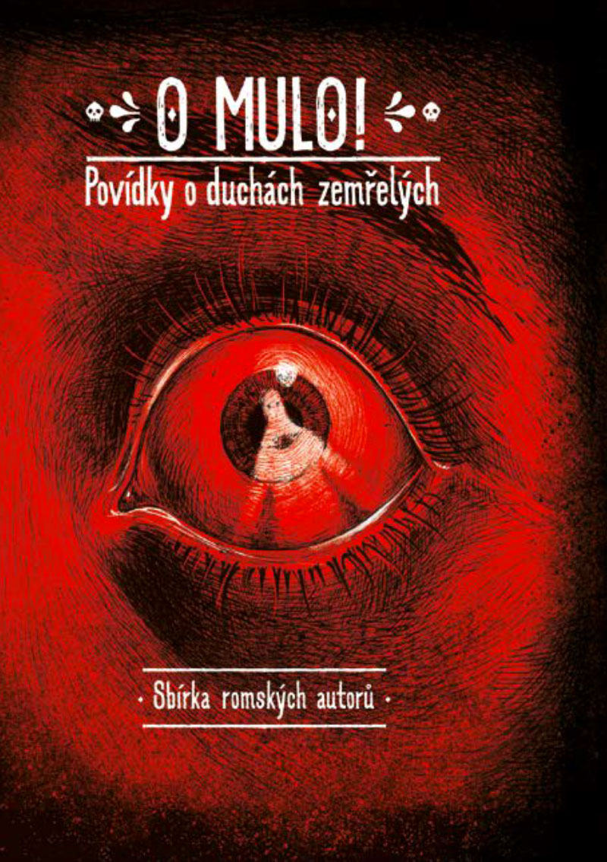
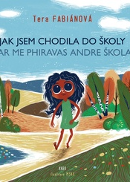
Publishing house Kher https://kher.cz/katalog/autori/

Slide 5
Women Romani Literature
After the WWII
Memory of Holocaust
Social Relations, Family and Domestic Violence
Oral tradition
2. Contemporary Literature
Social topics
Stereotypes
Violence
Problems of exclusion
Karolína Ryvolová - „Female authors are much more inclined not to mask problems. Their themes are more political.“

Slide 6
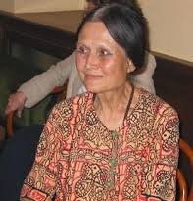
Milena Hubshmannová 1933-2005
The founder of Czech/Slovak Romany Studies Milena Hübschmannová died, aged 72, in a car accident in South Africa. She was born in Prague on July 10, 1933. She first became interested in Romany language after she had graduated from the Faculty of Arts, Charles University, where she had majored in Urdu, Hindu and Bengali. Since Romany was not taught anywhere in those times for political reasons, she mastered it among the native speakers with whom she became close friends.
She played a major part in the running of the Association of Gipsy-Roma (1969-1971), in which she chaired the social science committee. Thanks to her unyielding effort, first a course of Romany was opened at the School of Languages in Prague in 1976, and later, in 1991, a separate department solely for Romany Studies was established at the Charles University. She worked there as a teacher until her tragic death.
In 1991 she co-founded the Association of Gypsies-Romanies, forcedly dissolved by communists in 1973. She is the author of a Romany-Czech and Czech-Romany dictionary, and a text-book of the Romany language. She also translates Romany literature.

Slide 7
Orality of the roma writing
Reading
Petra Cech: Oral Literature
https://www.romarchive.eu/en/literature/oral-literature/oral-literature-article/

Slide 8
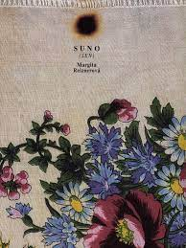
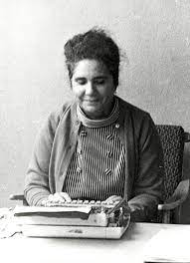
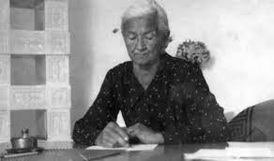
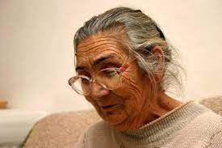
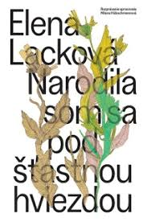
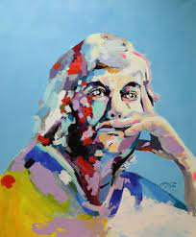
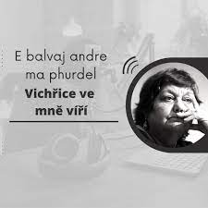
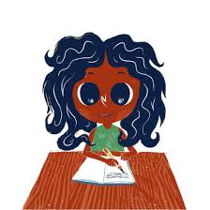
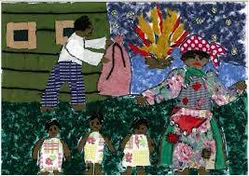
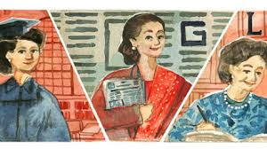
First Roma female Czech/Slovack writers
Elena Lacková
Tera Fabianová
Margita Reiznerová

Slide 9
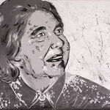
Elena Lacková 1921-2003
Graduated from Faculty of Arts Charles University
Activists (Union of Gypsies/Roma in 60ies banned in 70ies)
Drama Gipsy Camp on Fire 1946 Romani theather Romatan In Košice (Slovakia)
I Was Born Under a Lucky Star (Narodila jsem pod šťastnou hvězdou)
text was prepared by Milena Hubschmannová
https://observervoice.com/1-january-tribute-to-elena-lackova-17399/
Portrait by Jesef Fečo: https://www.portalsvk.sk/en/artifacts/elena-lackova-1

Slide 10
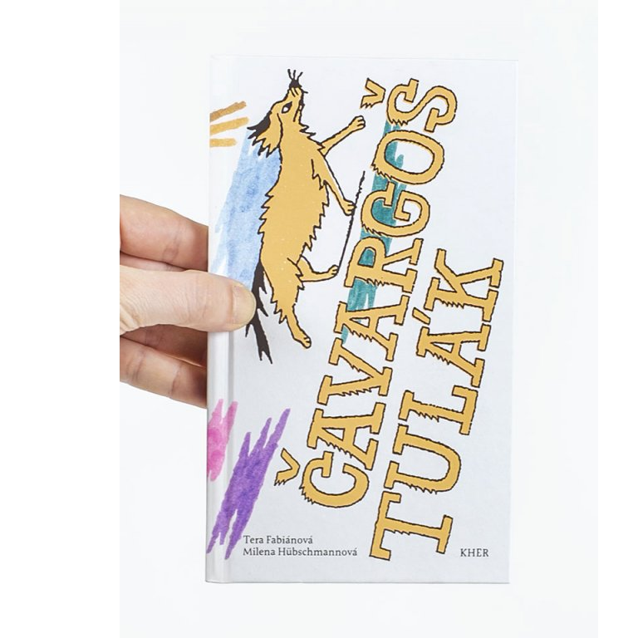
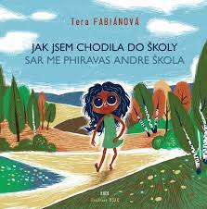
Tera Fabinova 1930 – 2007
Poet, storyteller, stories for kids in Roma dialects Ungriko,Serviko, performer
https://www.romarchive.eu/en/collection/p/tera-fabianova/

Slide 11
Tera Fabianová „How I Attended School".
"The teacher made me suffer. When my little sister Helena was born I was at the birth. I saw the miracle of someone being brought into the world. The midwife told me to bring water and cloths. It was cold and I helped to bring Helena into the world. We didn't have running water, I had to go to the well, I had to cut wood for the midwife.
The next day I went to school. We had Catechism - I sat down. Because I hadn't slept all night, I fell asleep. The priest said - hey, you bighead - because I had lots of hair - tell me how Jesus was born. And I said - Father, you've never seen it, but I was there when our Helenka was born. He gave me ten slaps with the cane on my bottom and on my hand. And he sent me off to the church to pray.“

Slide 12
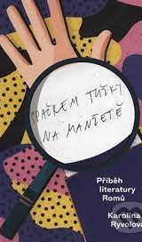
„to make it an orgoranic part of majority canons“
Karolína Ryvolová: Špačkem tužky na manžetě. (With a Pencil Stub on the Cuff. history of Romani literature on the territory of the Czech Republic.), Slovo 21, Praha 2021.
Memory, History, Criticism, Postcolonial theory
Goals:
Support for a modern literature, to integrate Romani literature in the field of major literature and „to make it an orgoranic part of majority canons“
Q: Berkyová R., Ryvolová K., A pocket guide to Romani Literature, in Neviditelné muzeum/Invisisble Museum/Nadikhuno Muzeumos. Tranzit, Bratislava 2019.
Discussion about Romani women, memory, art and literature
https://www.youtube.com/watch?v=COjrFg4HNCc

Slide 13
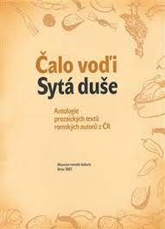
Roma/ Czech Contemporary Female Writers
Věra Horváthová Duždová
Stanislava Miková
Ilona Ferková
Květoslava Podhradská
Iveta Kokyová
Olga Fečová
Erika Oláhová
Irena Eliášová
Antologies of Roma Literature:
Čalo voďi/Sytá duše. (Helena Sadílková, Jana Kramářová eds.), Muzeum romské kultury. Brno: 2007)
Všude samá krása. Kher. Praha: 2021

Slide 14
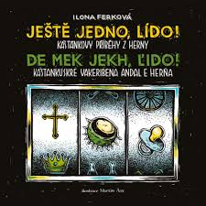
Ilona Ferková 1956
https://romove.radio.cz/en/clanek/20268
https://www.pametnaroda.cz/cs/ferkova-ilona-1956
(interview with Ilona Ferková)
Ilona Ferkova writes in the Romany language, closely related to the ancient Indian language Sanskrit. It has survived and adapted itself through the centuries ever since the ancestors of today's Roma left India a millennium ago. Ilona has written a fascinating collection of short stories that capture both the tribulations and the poetry that shines even through the material hardship of life for many Roma in the Czech Republic today.

Slide 15
Ještě jednou, Lído. Kaštánkovy příběhy z herny.
https://ct24.ceskatelevize.cz/kultura/2677220-jeste-jedno-lido-romske-pribehy-z-herny-maji-svou-hrdost
The book, subtitled Kaštánek's Tales from the Gambling House, looks at the gamblers of Rokycany and the surrounding figures through the eyes of a local "scrounger" and underdog. However, Kaštánek is not just a literary figure, but a real Rokytown character. "He has become homeless and goes to the gambling club either for a beer or to entertain the others who sit there. And I liked his stories so much that I thought I could write it all down," explains Ilona Ferková why she put Kaštánek's stories on paper.

Slide 16
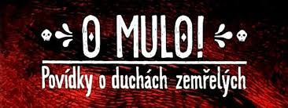
vakeribena pal o mule - the stories about the soul of the deads
Mulo, Mule
mulo (Sg. m.), mule (Pl. m.) - "dead, ghost(s) of the dead";
Belief in the mulo is shared by many members of different Roma communities. A mulo can appear to settle accounts with someone, because s/he is missing something in the next world, because s/he disapproves of the behaviour of her/his survivors, but also to warn a dear survivor of a threat of danger. Usually a mulo strikes fear, but may also behave quite "normally" or represent a threat to living people.
Source and further reading: ROMBASE © by Milena Hübschmannová 2002
Vakeriben "story, tale, talking, dialect"
In many traditional Slovak Romani communities, "vakeriben" (m.) was one of the favorite pastimes. It had various forms and functions, each of which took on a different name. Some types of vakeriben can be thought of as semi-formalised or non-formalised epic genres of Romani literary culture.
Source and further reading: ROMBASE © by Milena Hübschmannová 2002
https://www.romarchive.eu/en/

Slide 17
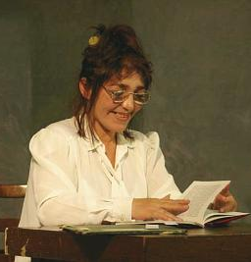
Erika Oláhová (1957 Zvolen- Slovakia)
Erika Oláhová does not feel as Roma writer, she was ironic towards her own culture.
Short stories
Nechci se vrátit mezi mrtvé
Matné zrcadlo
(edited by Jan Červenka for Triada publishing https://www.i-triada.net/product-page/erika-olahová-nechci-se-vrátit-mezi-mrtvé)
Antology: Čalo voďi/ Sytá duše
Documentary fim Erika píše horory/Erika writes the horror stories (2005, dir. Adam Gebert) https://www.youtube.com/watch?v=N925staljTU

Slide 18
Stanislava Miková – Děda mi dal pero do kolíbky
https://www.youtube.com/watch?v=yjx_Qe3-GF0
„Romani literature is not declining. It is on the rise. More and more people are writing in Romani.

Slide 19
Some sources in English and questions
Bernie Higgins:
"Povidky": a new collection of short stories by fourteen Czech women in English translation“
https://romove.radio.cz/cz/clanek/21025
The Reading for the discusion available in PDF directly send with this presentation
Task and Questions:
Find some examples of the orality in the texts.
Why the deads are so important?
What was the most suprising feature of the Roma texts you have read?

