Slide 1
Effective Communication and Teamwork
Kamil Kotlík

Slide 2
Communication
The basic form of human interaction
Not only speech but all behaviour is communication and all communication influences behaviour (Watzlavik 1969).
We always create, influence and modify communication together, and at the same time we are also part of this communication and are influenced by it.​.

Slide 3
Basic Division of Communication
Sharing
Transfering content
Non-verbal
Verbal

Slide 4
Communication Competences
Sum of communication knowledges, skills and attitudes
- language skills - speed and code picking skills - influence of self-concept and self-confidence - influence of central traits

Slide 5
Communication Functions
Verbal
Inform
Instruct
Entertain
Convince
Non-verbal
Support speech
Replace speech
Express emotion
Express an attitude
Express yourself (introduce yourself)

Slide 6
Keep in Mind that:
It is impossible not to communicate (we always communicate something - even by not communicating
Every behaviour in the presence of another is communication
Non-verbal communication quite often expresses the hierarchy and status of an individual in a given society (soldiers, etc.)
Unsynchronized speech and gestures disturb or confuse the recipient
Everyone has own non-verbal tempo, which is difficult to change
A person in tension tends to have an unchanging facial expression
Smile triggers feedback (facilitates)
Looks go in 90 % at the other person's face (75 % between eyes and mouth)

Slide 7
Chosen Informal Rules of Communication
Rituals
The halo effect
Atributive assessment
The 7-second rule
Personal zone
Right and left up

Slide 8
Recognize Communication Fouls, don‘t use them and Resist them!
Frequent communication fouls
Communication maneuver
Disqualification
Mystification (e. g. generalization)
Paradoxical communication (double bind)
Sugestion

Slide 9
Basic Defense Against Communication Fouls
Do not play a dirty game = do not accept it.
Watch your emotions.
Don't moralize.
Shift the burden of proof!!!

Slide 10
Signs of a Deceptive Communication
Mismatch of verbal and non-verbal components of communication
Significantly different psychomotor pace
Eye movements (averting eyes etc.)
Unnatural facial expressions
Loss of eye contact

Slide 11
Stress and Communication
Communication can be both a source of stress and affected by stress
Sources of stress:
Physical (hunger, etc.)
Psychic (complexes)
Mental (desire to outdo others, lack of time)
Social (failure in training or competition, threat of sanctions, loss of job)
Psychological stressors – persistent; others – usually temporary or momentary
Tunnel vision
Limited capacity for perception and reception
Retroactive attenuation (no new impulses are processed)
Rigidity
Degradation to developmentally older patterns of communication

Slide 12
Communication in the tTeam
The influence of the team on the communication context
Personal vs. substantive or procedural satisfaction
Horizontal or vertical team
Bearers of influence and bearers of interest

Slide 13
Principles of Effective Communication in the Team
Open and regular communication: Communication should be open, regular and transparent. The team should be able to share information, opinions and insights.
Listening: It is important to actively listen to other team members and take their opinions and ideas into account.
Clear and specific communication: Messages should be clear, concise and specific. This prevents unnecessary misunderstandings.
Mutual respect and recognition: Each team member should be respected and recognized for their contributions and efforts.
Constructive feedback: Feedback should be constructive and aimed at supporting and growing the team.
Conflict resolution: Conflicts in the team should be resolved openly and constructively so as not to disrupt the work environment.
Flexibility and adaptability: As part of communication, the team should be open to new ideas and able to quickly adapt to changes.
Creating a pleasant atmosphere: It is also important to create a pleasant working atmosphere where team members feel supported and motivated.

Slide 14
What to Avoid in Team Communication?
Unclear setting of goals and roles
Interrupting
Generalization

Slide 15
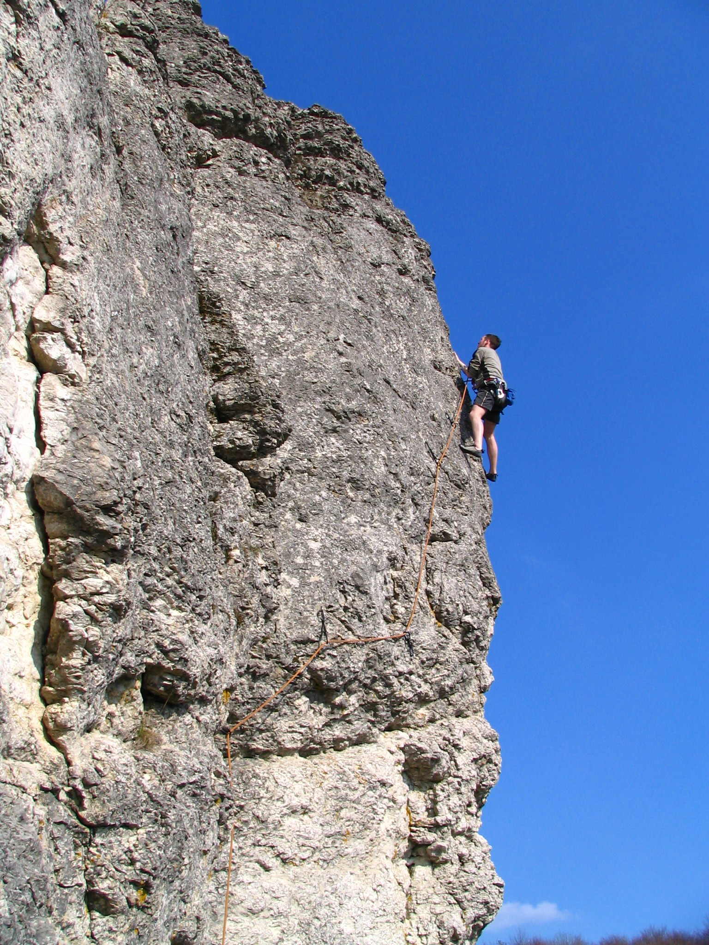
Resolving Disagreements in the Team
Problem vs. dispute
Problem solving: structure the procedure well (problem definition, agreements on defining the roles of solvers, agreements on process and solutions, solutions)
Dispute resolution: legitimize emotions, make the human dimension of the dispute the object of attention
It is beneficial to progress from convergent to parallel and then to divergent interests
Mountain climbing method (hammering the belay in the form of partial agreements from simple to more difficult)

Slide 16
Development of the Conflict
7 main stages of conflict development
- Warning gigns
Differences
Polarity
Separation
Destruction
Exhaustion
Latency
There should be an effort to (solve) the conflict at the earliest possible stage

Slide 17
Basic Conflict Resolution Techniques
Do participants control the conflict resolution process? |  |  | random | negotiation
 |  | YES | violence | discussion
 |  | NO | delegation | mediation
 |  |  | Pasivity | facilitation
 |  |  | NO | YES
 |  |  | Do participants control the outcome of conflict resolution?

Slide 18
Negotiation
Bearers of influence and bearers of interest
- For a good deal, influencers are as important as interest bearers
Origin of influence
- It follows from the substance (e.g. good BATNA, legitimacy of claims, etc.), formal or informal aspects
Analysis of interests - it is necessary to assess the relative importance of the identified interests for each party to the conflict
Interests:
key – they define the essence of the negotiation space
important – they outline the negotiation space, we are ready to give way in them in response to concessions by the counterparty in our key interests
secondary – they do not have a great influence on our decision-making, the area of ​​prepared concessions
virtual - marginal

Slide 19
Thank you for your attention!

