Slide 1
Title
names of group members

Slide 2
Introduction (short)
Why this topic?
The aim of this presentation? For example:
The aim of this presentation is to describe …..
Or
The aim of this presentation is explored ……

Slide 3
Methods
Eligibility Criteria
Search Strategy
Search keywords
Search term
Databases (for example PubMed, Cinahl, …. )
Study Selection and Data Extraction

Slide 4
Results
The PRISMA flow diagram
Study Selection
For example
(https://www.prisma-statement.org/prisma-2020-flow-diagram )

Slide 5
Results (Characteristics of the included studies)

Slide 6
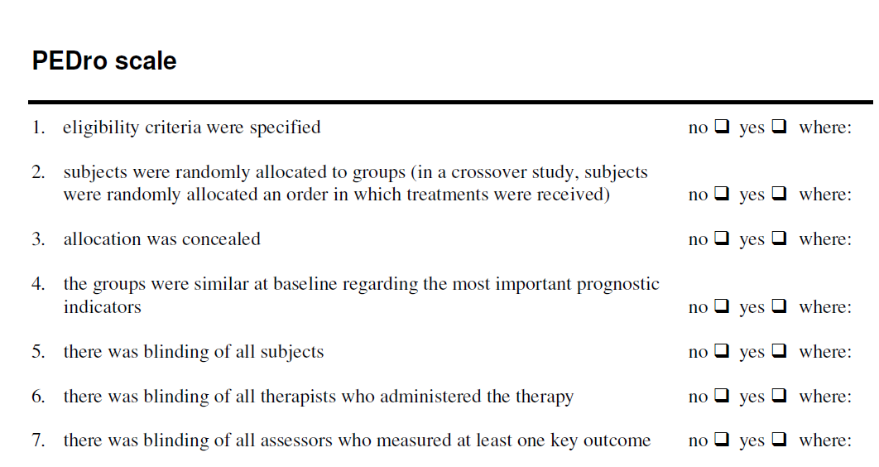
Results (evaluation)
(https://pedro.org.au/english/resources/pedro-scale/ )

Slide 7
Results (evaluation)

Slide 8
Conclusion
Highlight the conclusions you’ve drawn from your research and whether you’ve answered your main question

Slide 9
References

